Slide 1
Building a Data Pipeline for Sleep Health Analysis
Rameswaram Kumar Viswanath MSDS - 610

Slide 2
Project Overview
The primary objective of this project is to build a robust data pipeline that can effectively process and prepare sleep health data for machine learning tasks. We'll be using the Sleep Health and Lifestyle Dataset from Kaggle, which contains various features related to sleep patterns, lifestyle, and health indicators. This processed data can then be used to train models for predicting sleep quality and identifying key factors that influence sleep

Slide 3
Data Pipeline
Data Extraction
Data Cleaning & Transformation
Data Validation & Quality Checks
Feature Preprocessing
Feature Engineering
Model Training/Inference
Data Storage
Model Training Data Preparation
Monitoring & Feedback
Notes:
Data Extraction: Extract raw data from PostgreSQL.
Data Cleaning & Transformation: Handle missing values, duplicates, and outliers. We can drop the duplicates here and handle the missing values using imputation methods and remove the outliers using IQR methods
Data Validation & Quality Checks: Validation ensures our cleaning worked as expected. We're checking for consistency, verifying values are within acceptable ranges, examining distributions, and confirming that our imputation strategy was effective.
Feature Preprocessing: Preprocessing prepares features for modeling. Scaling ensures that all numerical features contribute equally, and encoding converts categorical variables into a numerical format suitable for machine learning algorithms.
Feature Engineering: Create new features for model training. Feature engineering creates potentially more informative features.
Data Storage: Store the processed and engineered data in Parquet format
Model Training Data: Prepare the final dataset for model training. Split data into training (70%), validation (15%), and test (15%) sets, stratified by target.
Model Training/Inference: Train the model and generate predictions.
Monitoring & Feedback: Continuously monitor the data pipeline to ensure it is running smoothly and provide feedback for improvements..

Slide 4
Pipeline Type
Pipeline Type: Batch Processing
Justification:
The dataset is static and does not require real-time updates.
Batch processing is efficient for historical data analysis and periodic model training.
Suitable for time-insensitive tasks where real-time processing is not required.
This is Simpler to implement when Compared to streaming.
Notes:
The reasons to implement batch processing are:
Batch processing is chosen because the dataset is not updated in real-time.
This approach is cost-effective and suitable for daily or weekly model updates.
Daily model training suggests periodic processing is sufficient.
Batch processing allows for more comprehensive data quality checks.
We can efficiently process the entire dataset at once, and then periodically retrain the model on updated data batches.
Finally Batch processing is well-suited for this project because our primary task is to train a model on historical sleep data. Model training is inherently a batch operation. We can efficiently process the entire dataset at once, and then periodically retrain the model on updated data batches. While real-time processing might be relevant for future extensions like integrating data from wearable devices, for the initial model development and training phase, batch processing offers a good balance of simplicity and efficiency

Slide 5
Data Format
Chosen Format: Parquet
Reasons:
Efficiency: Columnar storage optimized for large-scale data processing.
Compression: Reduces storage costs and improves query performance.
Compatibility: Works well with distributed systems like Apache Spark.
Use Cases:
Storing processed data for machine learning tasks.
Analytical queries and aggregations.
Notes:
Parquet is a columnar storage format that is highly optimized for analytical queries and machine learning. It offers significant advantages in terms of storage efficiency and query performance compared to row-based formats like CSV. Its columnar nature allows for efficient retrieval of specific columns, which is very beneficial when training machine learning models that might only use a subset of the features. Its columnar nature allows for efficient retrieval of specific columns, which is very beneficial when training machine learning models that might only use a subset of the features.

Slide 6
Data Quality Issues
Potential Issues:
Missing Values: Some fields like sleep duration, stress level may have null values. Missing entries can distort analysis and predictive models.
Duplicates: The dataset may contain duplicate records for the same individual. Duplicate records can inflate metrics and skew analysis.
Outliers: Extreme values in metrics like sleep duration , physical activity level or stress level . Extreme values can distort analysis and affect model performance.
Notes:
This involves handling missing values, removing duplicates, and addressing outliers. For instance, if we find missing values in the 'Sleep Disorder' column, we might impute them with ‘No sleep disorder’ as it indicates no sleep disorder value. If found any duplicate values I will drop the duplicated records. Outlier handling will be done using the IQR method, where we identify and remove data points that fall outside a certain range of the interquartile range. But choosing this can be sensitive on some data and so outliers can be removed based on the some of the columns like physical activity sleep duration and stress level

Slide 7
Data Validation and Monitoring
Validation Checks and monitoring:
Missing Values: Count null values in each column and impute or remove them based on the null values and checking the total null values of all columns using assert statement
Duplicates: Checking duplicates of all records and dropping them and verifying the counter afterwards using assert statement
Outliers: Apply statistical methods like IQR to detect and handle outliers and removing outliers from selected columns and checking the count afterwards
Notes:
For handling missing values I considered the distribution of data in each column. For numerical columns, i checked the skewness to decide between mean and median imputation where if skewness exists I choose median otherwise mode . For non-numerical columns, I am using mode imputation, which is appropriate for categorical data. For duplicate rows I am dropping them directly. i removed, using the Interquartile Range (IQR) method to identify outliers .i have applied this method to specific numerical columns that are relevant for outlier detection in sleep health data. The function I used returns both the cleaned dataframe and the outliers, which is useful for further analysis if needed. After this I have kept some validation checks Checking for missing values across the entire dataframe , the duplicate check ensures all duplicates have been removed and the outlier check using IQR is consistent with your removal method and verifies that outliers have been addressed in the specified columns.

Slide 8
Detecting Data Drift and Schema Changes
Data drift and schema changes can occur over time, affecting the performance of pipeline and models.
Data Drift:
Definition: Changes in the statistical properties of the data over time (e.g., mean, standard deviation).
Detection:
Use statistical tests (e.g., Kolmogorov-Smirnov test) to compare the distribution of new data with historical data.
Track key metrics (e.g., mean, median, standard deviation) over time and set thresholds for alerts.
Schema Changes:
Definition: Changes in the structure of the data (e.g., new columns, changed data types).
Detection:
Compare the schema of new data with the expected schema.
Storing schema definitions in a version control system (e.g., Git) to track changes over time and easily revert to previous versions if needed
Notes:
We have to Regularly calculate and track key statistical properties (mean, standard deviation, distributions) of input features. Compare these statistics over time to identify significant deviations from the baseline. Statistical tests (e.g., Kolmogorov-Smirnov test, Chi-squared test) formally compare the distributions of current data and the training data. These tests can help quantify the degree of drift. Implementing automated schema validation checks in data pipeline. These checks should compare the current data schema against a predefined or expected schema. By proactively monitoring for data drift and schema changes, we can ensure your data pipeline remains reliable, your machine learning models continue to perform accurately, and we can take timely action to address any issues that arise. This is a critical aspect of building and maintaining machine learning systems in real-world applications.

Slide 9
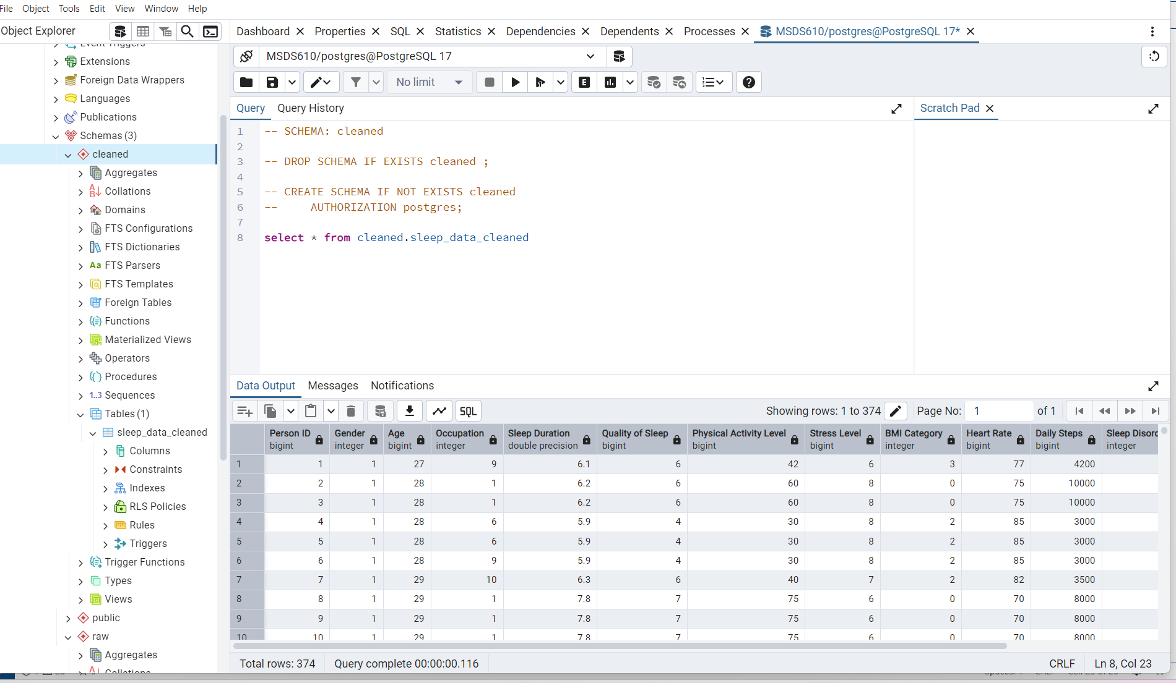
Table in cleaned schema

Slide 10
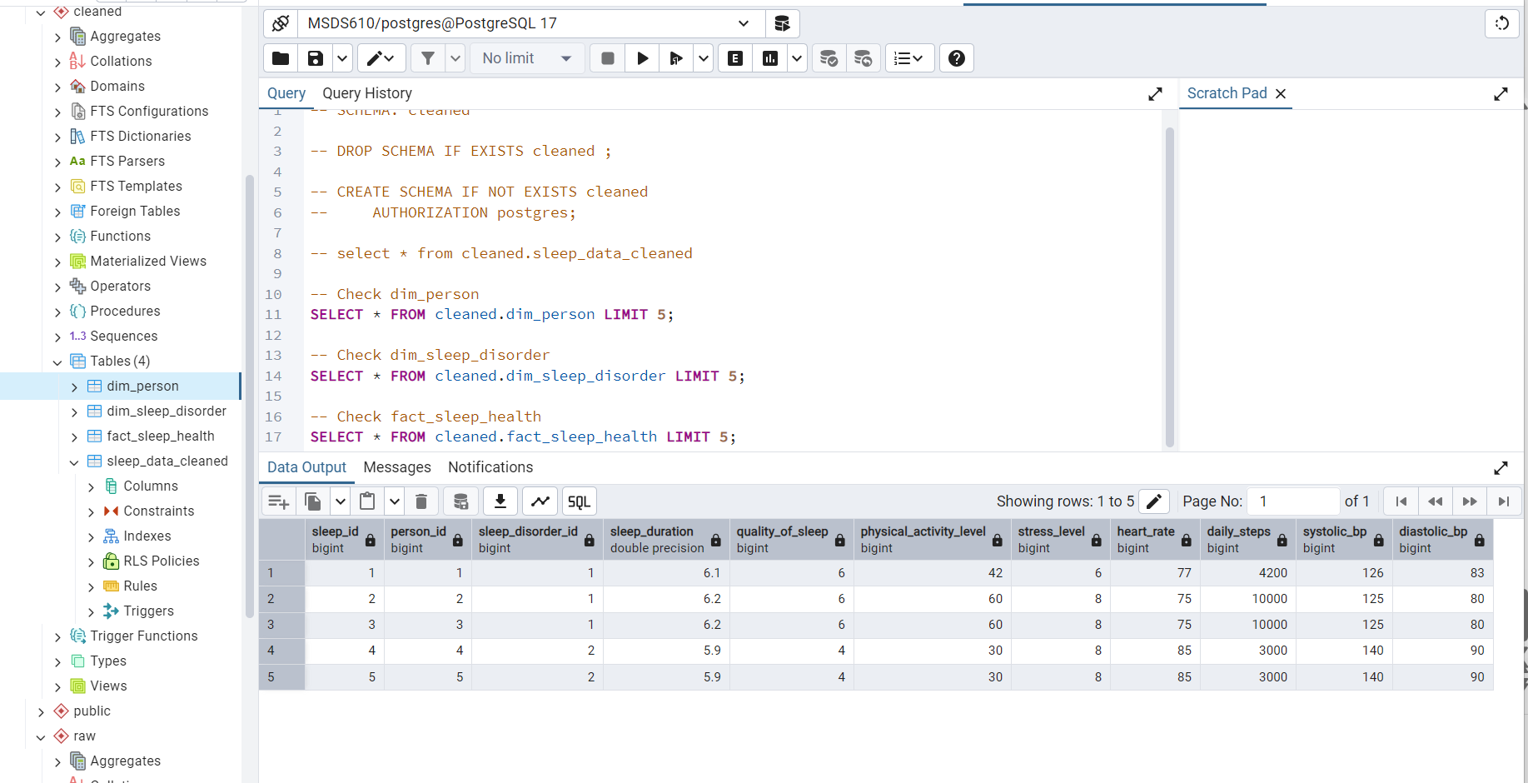
Star schema
Notes:
Definition:
A star schema is a type of database schema commonly used in data warehousing and analytics.
It is designed to make data retrieval and analysis efficient by organizing data into a central fact table and surrounding dimension tables.
The fact table contains the measurable, quantitative data, while the dimension tables contain descriptive attributes.
Structure:
The fact table is the core of the star schema. It stores the numerical data that we want to analyze.
The dimension tables provide context to the data in the fact table. For example:
dim_person: Contains information about individuals
dim_sleep_disorder: Contains information about sleep disorders.
Each dimension table is connected to the fact table through a foreign key.
Key Features:
Simplicity: The star schema is easy to understand and implement, even for non-technical users.
Query Optimization: It is optimized for read-heavy operations like aggregations and joins, making it ideal for analytics.

